Slide 1
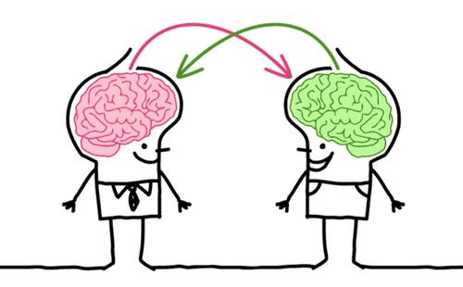
Transfer Learning --Domain Adaptation
Content:
Next work can be done;
Non-negative Matrix Factorization
Co-graph adaptation
The work can be discussed in the future.
Jinfeng Li
20191008

Slide 2
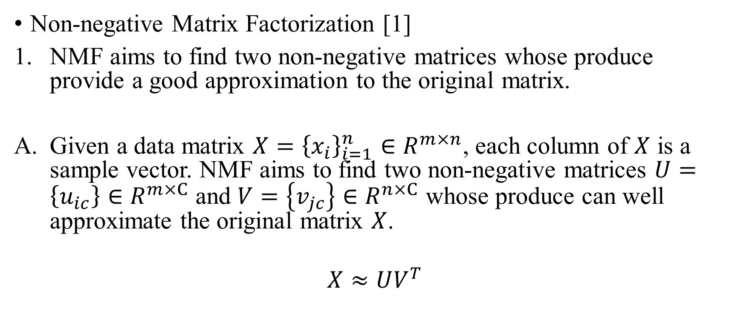
Next Work
Non-negative Matrix Factorization [1]
NMF aims to find two non-negative matrices whose produce provide a good approximation to the original matrix.
Given a data matrix $X={\left\{x_{i}\right\}}_{i=1}^{n}∈R^{m×n}$, each column of $X$ is a sample vector. NMF aims to find two non-negative matrices $U=\left\{u_{ic}\right\}∈R^{m×C}$ and $V=\left\{v_{jc}\right\}∈R^{n×C}$ whose produce can well approximate the original matrix $X$.
$$X≈UV^{T}$$
[1] D. D. Lee and H.S. Seung, “Learning the parts of objects by nonnegative matrix factorization”, Nature, 401, pp. 788-791, 1999.

Slide 3
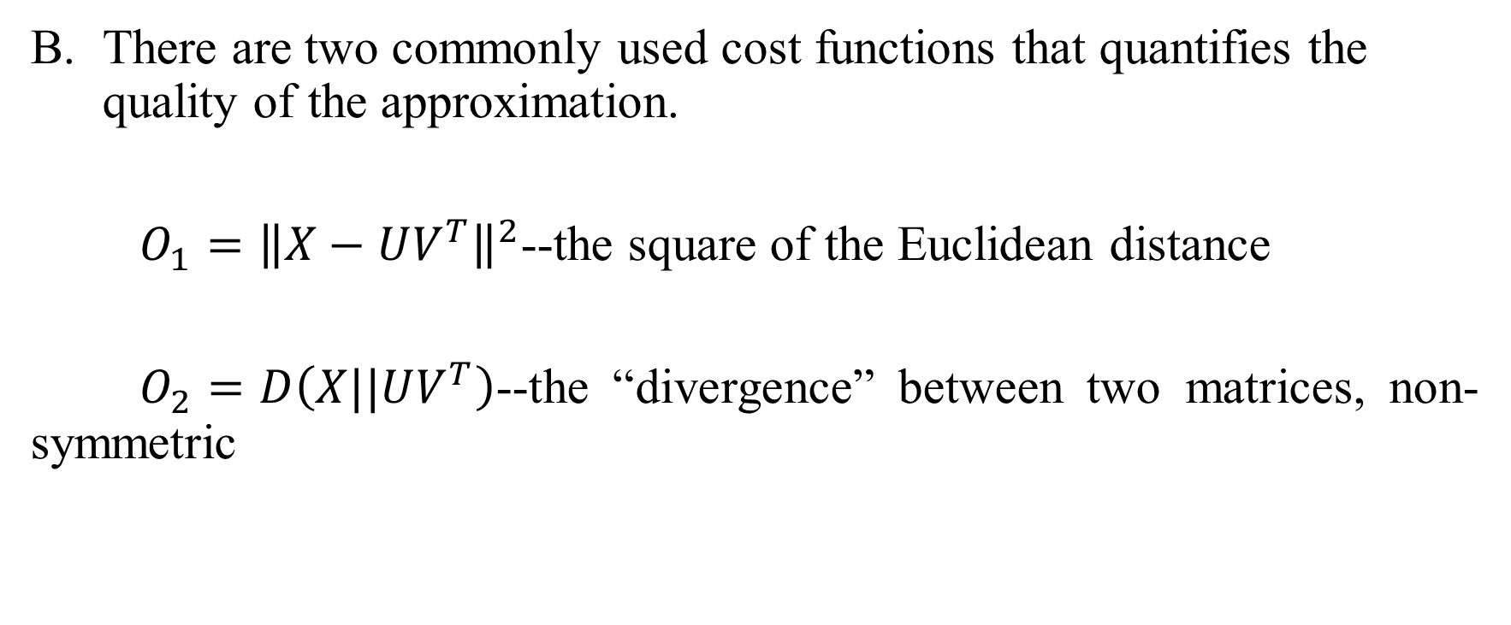
Next Work
There are two commonly used cost functions that quantifies the quality of the approximation.
$O_{1}={\left\|X−UV^{T}\right\|}^{2}$--the square of the Euclidean distance
$O_{2}=D\left(X||UV^{T}\right)$--the “divergence” between two matrices, non-symmetric

Slide 4
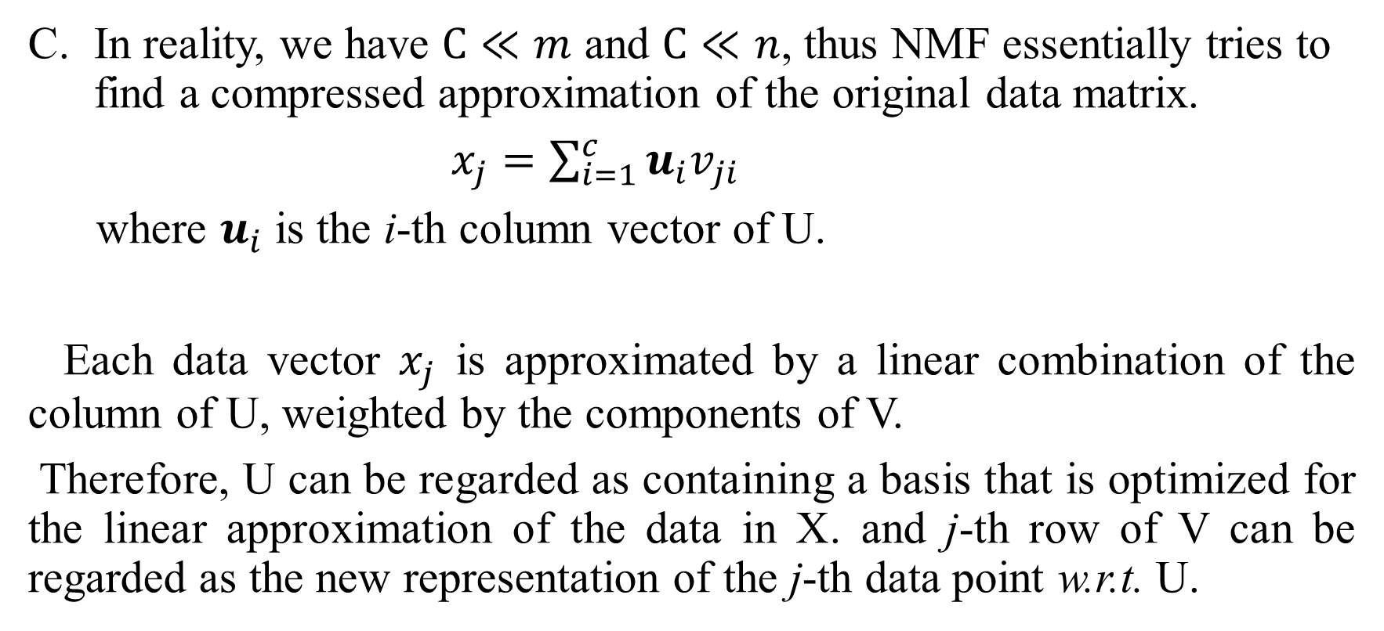
Next Work
In reality, we have $C≪m$ and $C≪n$, thus NMF essentially tries to find a compressed approximation of the original data matrix.
$x_{j}=\sum_{i=1}^{c}{u_{i}v_{ji}}$
where $u_{i}$ is the i-th column vector of U.
Each data vector $x_{j}$ is approximated by a linear combination of the column of U, weighted by the components of V.
Therefore, U can be regarded as containing a basis that is optimized for the linear approximation of the data in X. and j-th row of V can be regarded as the new representation of the j-th data point w.r.t. U.

Slide 5
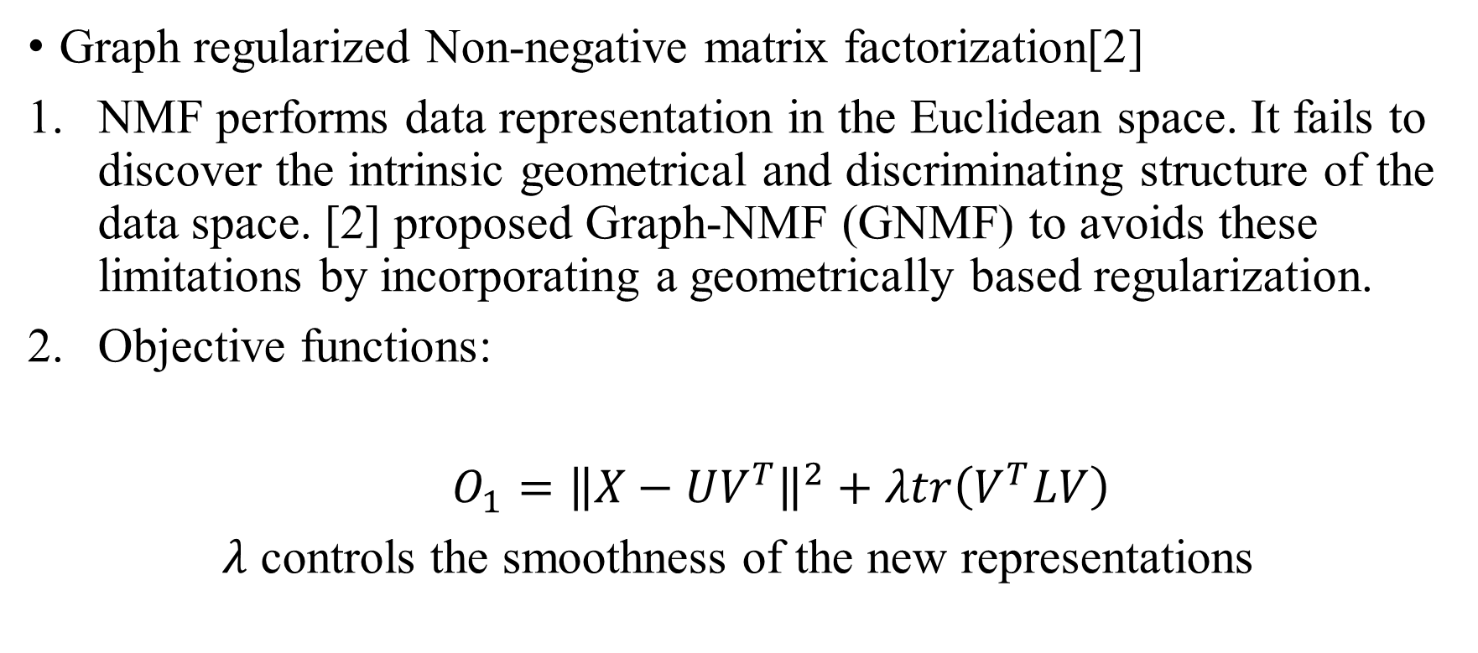
Next Work
Graph regularized Non-negative matrix factorization[2]
NMF performs data representation in the Euclidean space. It fails to discover the intrinsic geometrical and discriminating structure of the data space. [2] proposed Graph-NMF (GNMF) to avoids these limitations by incorporating a geometrically based regularization.
Objective functions:
$O_{1}={\left\|X−UV^{T}\right\|}^{2}+λtr\left(V^{T}LV\right)$
$λ$ controls the smoothness of the new representations
[2] D. Cai, X. He, J. Han, T. S. Huang, “Graph Regularized Non-negative Matrix Factorization for Data Representation”, IEEE Transactions on Pattern Analysis and Machine Intelligence, vol 33, no. 8, pp. 1548-1560, 2010

Slide 6
Next Work
Transfer Learning with Graph Co-Regularization [3]
The basic assumption is that the input domains may share certain knowledge structure, which can be encoded into common latent factors and extracted by preserving important property of original data, i.e., statistical property and geometric structure.
Statistical property: maximizing embedded variance or minimizing reconstruction error;
Geometric structure: referring to manifold, i.e., encoding similar instances with similar representation.
[3] M. Long, J. Wang, G. Ding, D. Shen, and Q. Yang, “Transfer Learning with Graph Co-Regularization”, IEEE Transactions on Knowledge and Data Engineering, vol. 26, no. 7, pp. 1805-1818, 2013

Slide 7
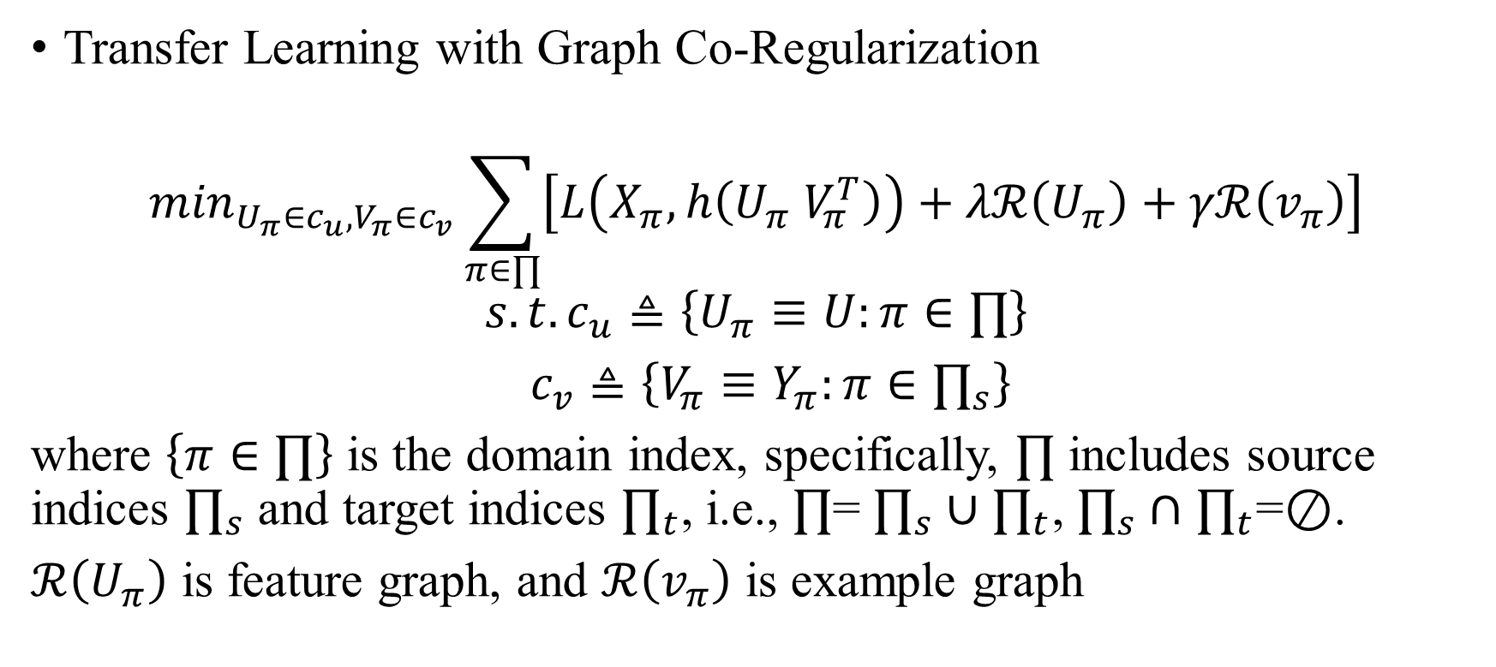
Next Work
Transfer Learning with Graph Co-Regularization
$$\min_{U_{π}∈c_{u},V_{π}∈c_{v}}\sum_{π∈∏}{\left[L\left(X_{π},h\left(U_{π} V_{π}^{T}\right)\right)+λℛ\left(U_{π}\right)+γℛ\left(v_{π}\right)\right]}$$
$$s.t.c_{u}≜\left\{U_{π}≡U:π∈∏\right\}$$
$c_{v}≜\left\{V_{π}≡Y_{π}:π∈∏_{s}\right\}$
where $\left\{π∈∏\right\}$ is the domain index, specifically, $∏$ includes source indices $∏_{s}$ and target indices $∏_{t}$, i.e., $∏$= $∏_{s}∪$ $∏_{t}$, $∏_{s}∩$ $∏_{t}$=$⊘$.
$ℛ\left(U_{π}\right)$ is feature graph, and $ℛ\left(v_{π}\right)$ is example graph

Slide 8
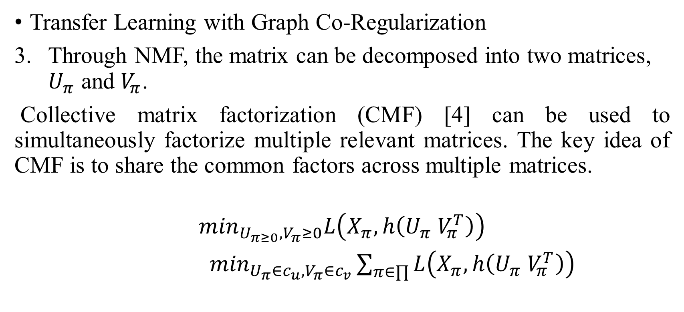
Next Work
Transfer Learning with Graph Co-Regularization
Through NMF, the matrix can be decomposed into two matrices, $U_{π}$ and $V_{π}$.
Collective matrix factorization (CMF) [4] can be used to simultaneously factorize multiple relevant matrices. The key idea of CMF is to share the common factors across multiple matrices.
$$\min_{U_{π≥0},V_{π}≥0}L\left(X_{π},h\left(U_{π} V_{π}^{T}\right)\right)$$
$\min_{U_{π}∈c_{u},V_{π}∈c_{v}}\sum_{π∈∏}{L\left(X_{π},h\left(U_{π} V_{π}^{T}\right)\right)}$
[4]A. P. Singh and G. J. Gordon, “Relational learning via collective matrix factorization,” in Proc.. KDD, 2008, pp. 650-658.

Slide 9
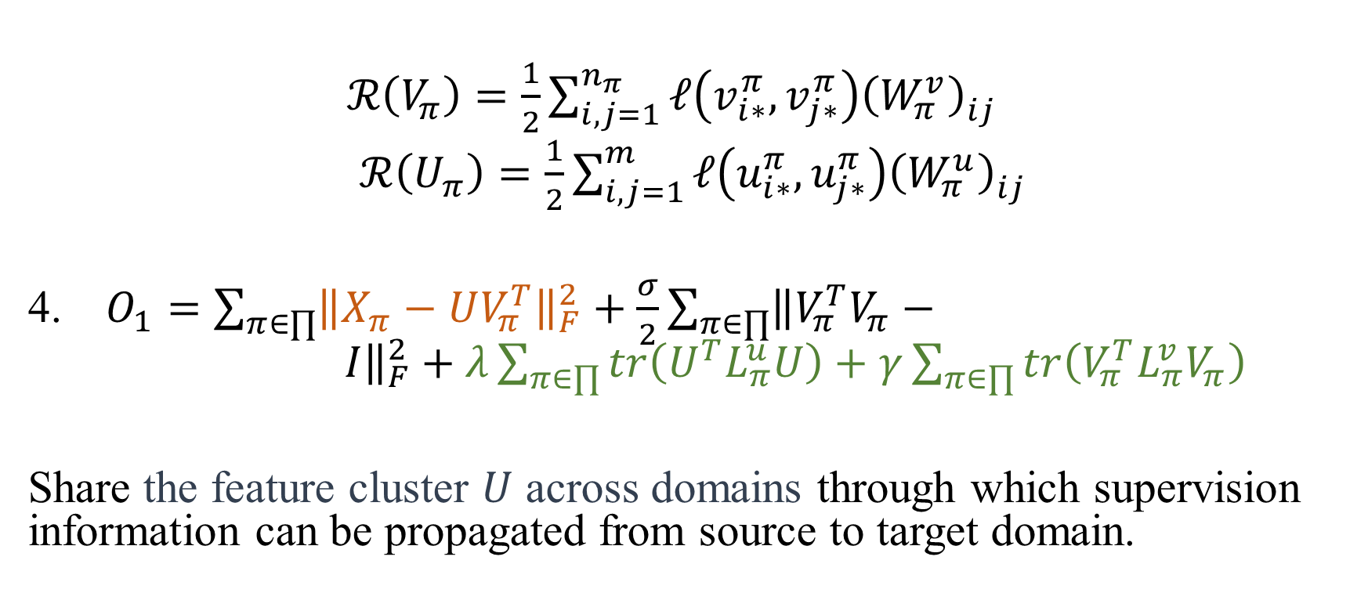
Next Work
$ℛ\left(V_{π}\right)=\frac{1}{2}\sum_{i,j=1}^{n_{π}}{ℓ\left(v_{i∗}^{π},v_{j∗}^{π}\right){\left(W_{π}^{v}\right)}_{ij}^{ }}$
$ℛ\left(U_{π}\right)=\frac{1}{2}\sum_{i,j=1}^{m_{ }}{ℓ\left(u_{i∗}^{π},u_{j∗}^{π}\right){\left(W_{π}^{u}\right)}_{ij}^{ }}$
$O_{1}=\sum_{π∈∏}{{\left\|X_{π}−UV_{π}^{T}\right\|}_{F}^{2}+\frac{σ}{2}\sum_{π∈∏}{{\left\|V_{π}^{T}V_{π}− I\right\|}_{F}^{2}+λ\sum_{π∈∏}{tr\left(U^{T}L_{π}^{u}U\right)+γ\sum_{π∈∏}{tr\left(V_{π}^{T}L_{π}^{v}V_{π}\right)}}}}$
Share the feature cluster $U$ across domains through which supervision information can be propagated from source to target domain.

Slide 10
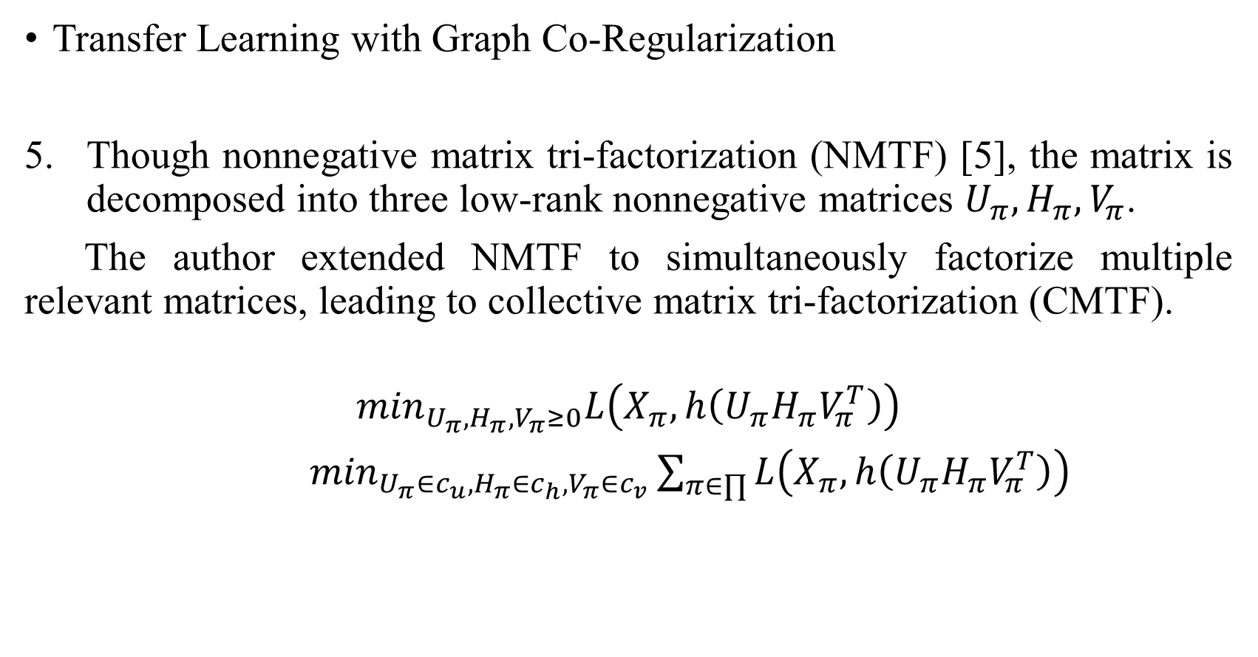
Next Work
Transfer Learning with Graph Co-Regularization
Though nonnegative matrix tri-factorization (NMTF) [5], the matrix is decomposed into three low-rank nonnegative matrices $U_{π},H_{π},V_{π}$.
The author extended NMTF to simultaneously factorize multiple relevant matrices, leading to collective matrix tri-factorization (CMTF).
$$\min_{U_{π},H_{π},V_{π}≥0}L\left(X_{π},h\left(U_{π}H_{π}V_{π}^{T}\right)\right)$$
$\min_{U_{π}∈c_{u},H_{π}∈c_{h},V_{π}∈c_{v}}\sum_{π∈∏}{L\left(X_{π},h\left(U_{π}H_{π}V_{π}^{T}\right)\right)}$
[5]C. Ding, T. Li, W. Peng, and H. Park, “Orthogonal nonnegative matrix tri-factorizations for clustering,” in Proc.. KDD, 2006.

Slide 11
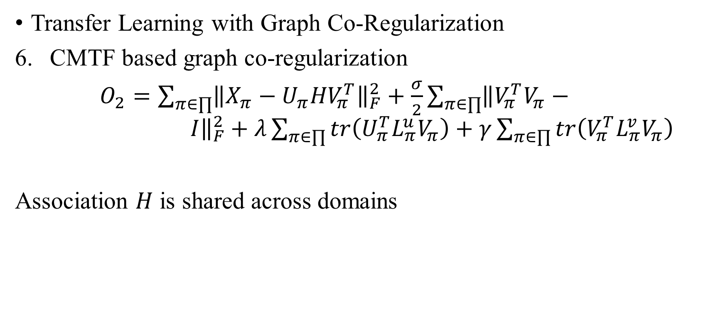
Next Work
Transfer Learning with Graph Co-Regularization
CMTF based graph co-regularization
$O_{2}=\sum_{π∈∏}{{\left\|X_{π}−{U_{π}HV}_{π}^{T}\right\|}_{F}^{2}+\frac{σ}{2}\sum_{π∈∏}{{\left\|V_{π}^{T}V_{π}− I\right\|}_{F}^{2}+λ\sum_{π∈∏}{tr\left({U_{π}^{T}L}_{π}^{u}V_{π}\right)+γ\sum_{π∈∏}{tr\left(V_{π}^{T}L_{π}^{v}V_{π}\right)}}}}$
Association $H$ is shared across domains

Slide 12
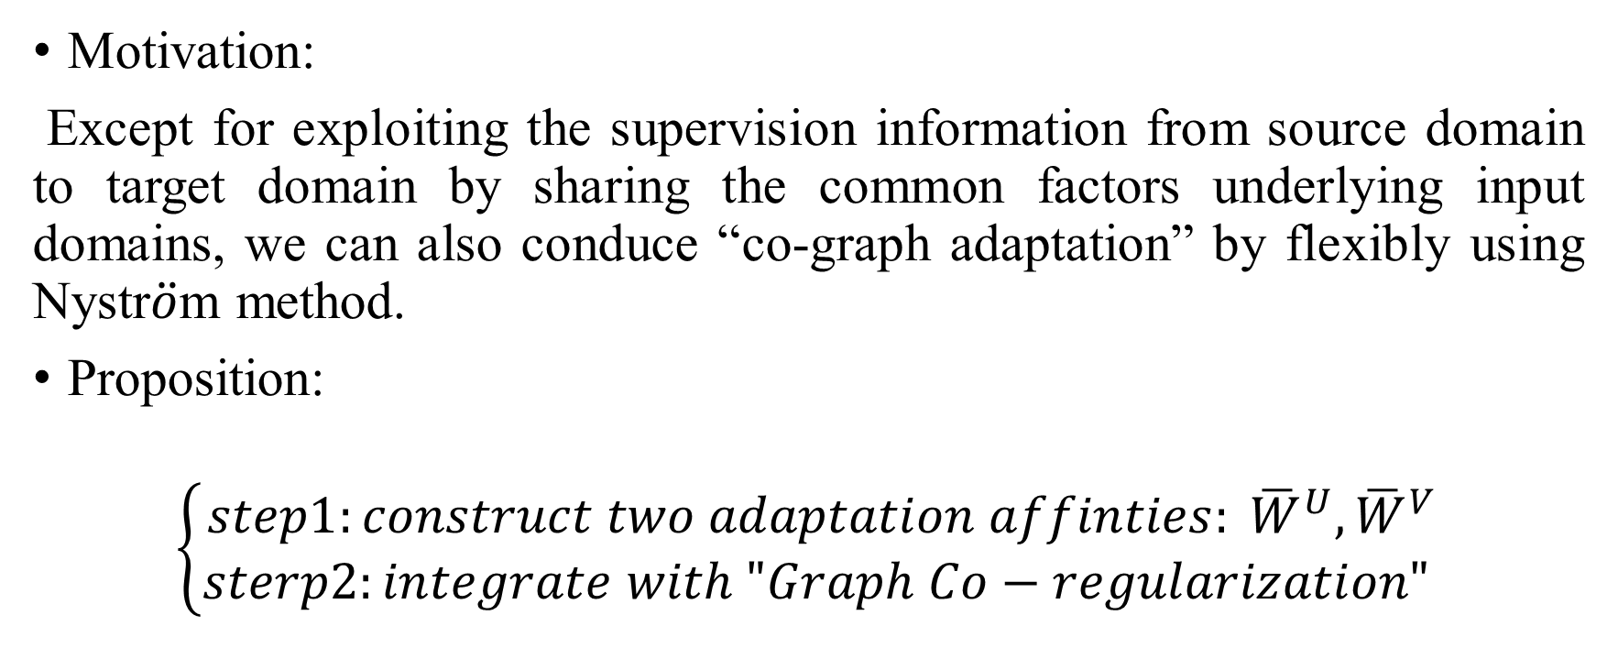
What can be done ?
Motivation:
Except for exploiting the supervision information from source domain to target domain by sharing the common factors underlying input domains, we can also conduce “co-graph adaptation” by flexibly using Nystr$\ddot{o}$m method.
Proposition:
$$\left\{\begin{aligned}step1:construct two adaptation affinties: {\overline{W}}^{U},{\overline{W}}^{V} \\ sterp2:integrate with "Graph Co−regularization" \end{aligned}\right.$$

Slide 13
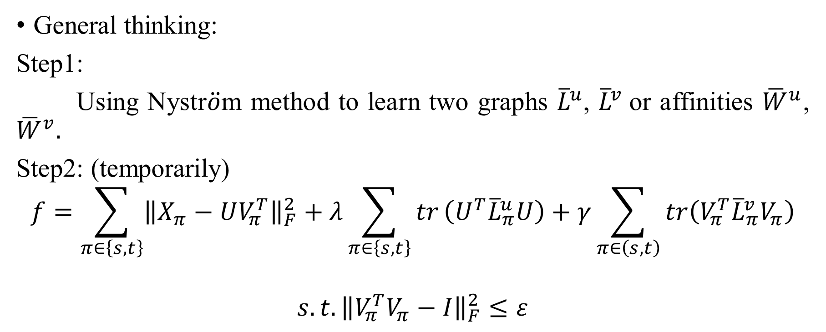
What can be done?
General thinking:
Step1:
Using Nystr$\ddot{o}$m method to learn two graphs ${\overline{L}}^{u}$, ${\overline{L}}^{v}$or affinities ${\overline{W}}^{u}$, ${\overline{W}}^{v}.$
Step2: (temporarily)
$$f=\sum_{π∈\left\{s,t\right\}}{{\left\|X_{π}−UV_{π}^{T}\right\|}_{F}^{2}+λ}\sum_{π∈\left\{s,t\right\}}{tr}\left(U^{T}{\overline{L}}_{π}^{u}U\right)+γ\sum_{π∈\left(s,t\right)}{tr\left(V_{π}^{T}{\overline{L}}_{π}^{v}V_{π}\right)}$$
$$s.t. {\left\|V_{π}^{T}V_{π}−I\right\|}_{F}^{2}≤ε$$

Slide 14
Future discussed work
Comparing Transfer Learning and Traditional Learning Under Domain Class Imbalance [6]
This paper provided comparative performance analysis between state-of–the–art transfer learning algorithms and traditional machine learning algorithms under the domain class imbalance condition.
An example of domain class imbalance with a binary class is when the source domain has a 10% positive class rate and the target domain has a 50% positive class rate.
The domain class imbalance condition is characterized by the source and target domains having different class probabilities.
[6] K. R. Weiss, and T. M. Khoshgoftaar, “Comparing Transfer Learning and Traditional Learning Under Domain Class Imbalance”, in Proc. ICMLA, 2017.

Slide 15
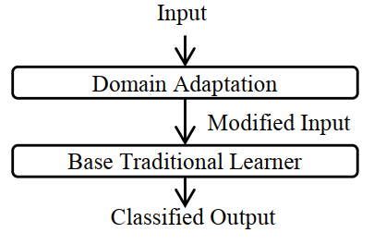
Future discussed work
Comparing Transfer Learning and Traditional Learning Under Domain Class Imbalance
The design structure of transfer learning methods typically takes on two different forms:
Domain adaptation step is integrated together
with the learning step;
Domain adaptation is performed
separately from the learning process.

Slide 16
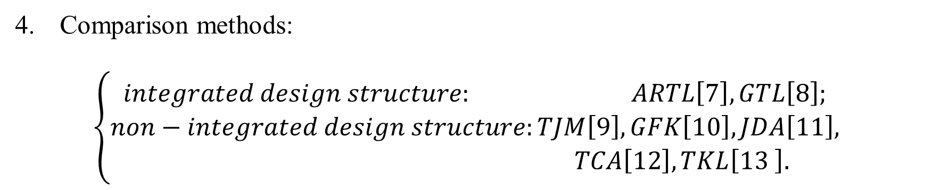
Future discussed work
Comparison methods:
$$\left\{\begin{aligned}integrated design structure: ARTL\left[7\right], GTL\left[8\right]; \\ non−integrated design structure:TJM\left[9\right],GFK\left[10\right], JDA\left[11\right], \\ TCA\left[12\right],TKL\left[13 \right].\end{aligned}\right.$$
[7] M. Long, J. Wang, G. Ding, S. J. Pan, and P. S. Yu, “Adaptation regularization: A general framework for transfer learning,” IEEE Transactions on Knowledge and Data Engineering, vol. 26, no. 5, pp. 1076–1089, 2014.
[8] M. Long, J. Wang, G. Ding, D. Shen, and Q. Yang, “Transfer learning with graph co-regularization,” IEEE Transactions on Knowledge and Data Engineering, vol. 26, no. 7, pp. 1805–1818, 2014.
[9]M. Long, J. Wang, G. Ding, J. Sun, and P. Yu, “Transfer joint matching for unsupervised domain adaptation,” in Proc. CVPR, 2014, pp. 1410–1417
[10] B. Gong, Y. Shi, F. Sha, and K. Grauman, “Geodesic flow kernel for unsupervised domain adaptation,” in Proc. CVPR, 2012, pp. 2066–2073.
[11] M. Long, J. Wang, G. Ding, J. Sun, and P. Yu, “Transfer joint matching for unsupervised domain adaptation,” in Proc. CVPR, 2014, pp. 1410–1417.
[12] S. J. Pan, I. W. Tsang, J. T. Kwok, and Q. Yang, “Domain adaptation via transfer component analysis,” IEEE Transactions on Neural Networks, vol. 22, no. 2, pp. 199–210, 2011.
[13] M. Long, J. Wang, J. Sun, and P. S. Yu, “Domain invariant transfer kernel learning,” IEEE Transactions on Knowledge and Data Engineering, vol. 27, no. 6, pp. 1519–1532, 2015.

Slide 17
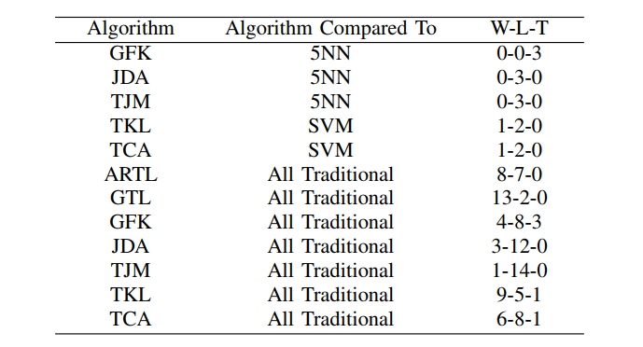
Experimental results
Number for W-T-L is W for outperform, L for under-perform and T for same.

Slide 18
Conclusion:
Transfer learning algorithms which are designed with non-integrated structure, none of these methods outperform their underlying based traditional learner.
When comparing these methods with all the other traditional learning algorithms, only TKL outperforms outperforms more often.
ARTL and GTL outperform the other traditional machine learning algorithms. With an integrated design structure, the results are better.

Slide 19
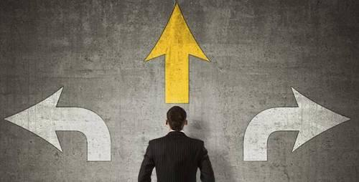
Q:
Many transfer learning methods fails when domain class imbalance occurs.
The methods that are proposed to solve the issue of class imbalance in traditional learning process.
How to address the domain class imbalance problem in transfer learning.

Slide 20
THANK U

Slide 21
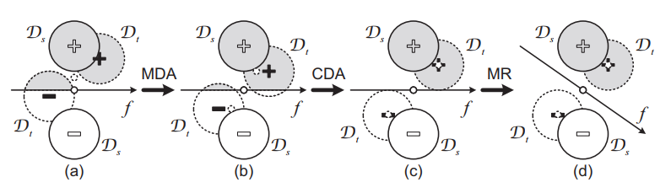
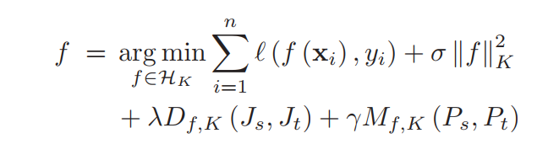
ARTL:

Slide 22
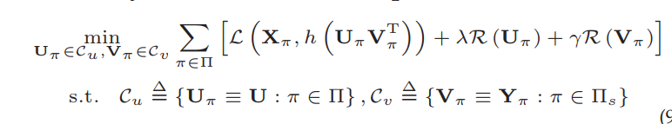
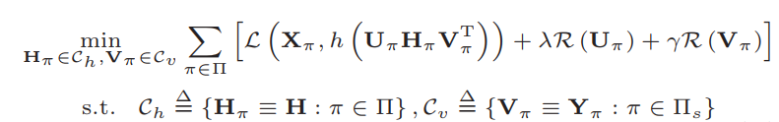
GTL:

Slide 23


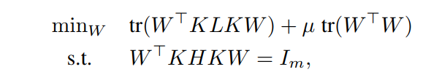
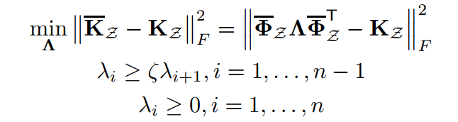
TJM:
JDA
TCA
TKL

